Slide 1
D-311 Unit 7: Maps

Slide 2
Objectives
Identify the different types of maps and how they relate to fire dispatching, planning and operations.
Effectively plot locations using latitude/longitude, grid maps, and township, range, and section.
Effectively locate and triangulate a given location using existing VOR systems.
Describe information needed to direct resources to a plotted location.

Slide 3
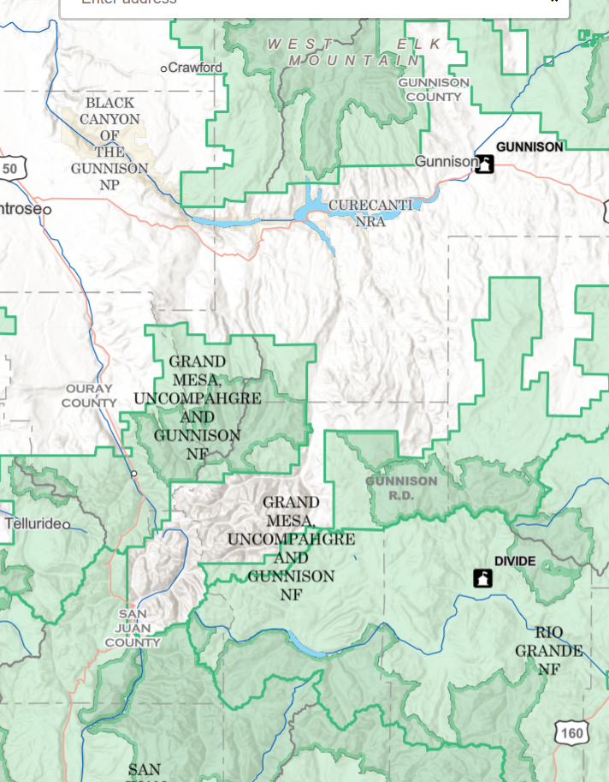
Purpose of Maps
What is the purpose of a map?
To visually represent information about the earth’s surface such as locations and distances and can assist with planning and organizing operations.
How are maps used in initial attack dispatch?
Location incidents
Plotting incidents
Directing resources

Slide 4

Map Accuracy
Two Reasons Map Accuracy is Imperfect
Representational inaccuracy
Measurement error

Slide 5
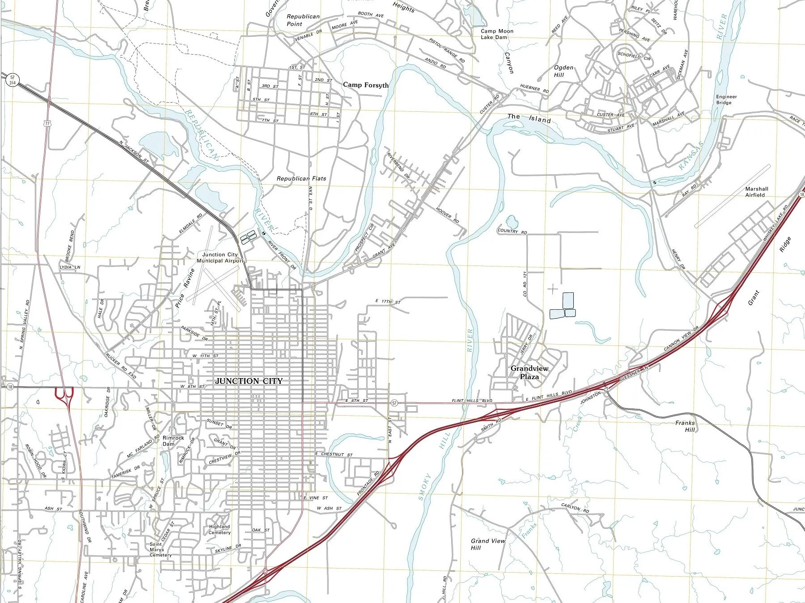
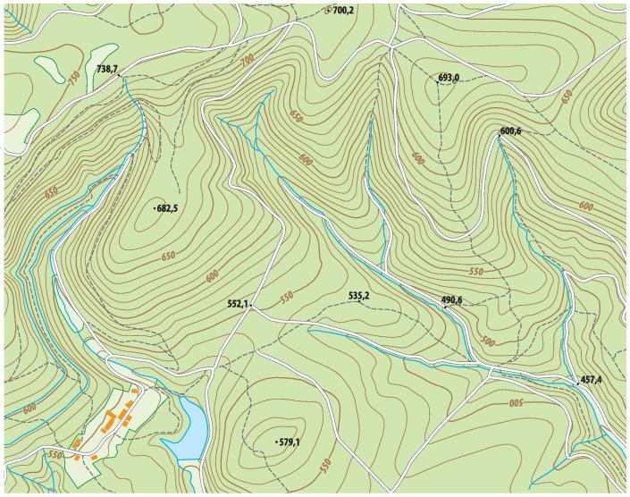
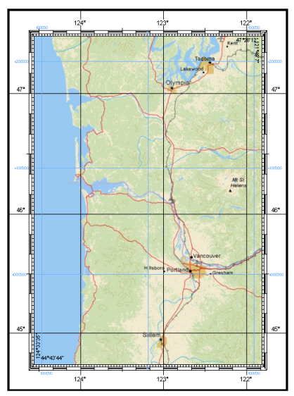
Classification of Maps
The three types of maps used primarily for initial attack dispatchers:
Planimetric
Topographic
Grid System

Slide 6
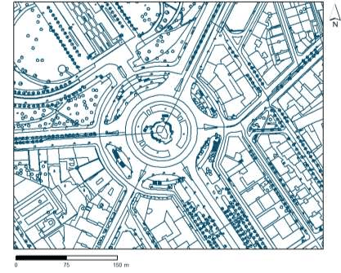
Classification of Maps
Planimetric Maps
Show the position of features with out showing their relationship to the hills and valleys of the land.
Can include rivers, lakes, roads, boundaries, or other human-made, symbolic features such as:
Common road maps
Schematic maps

Slide 7
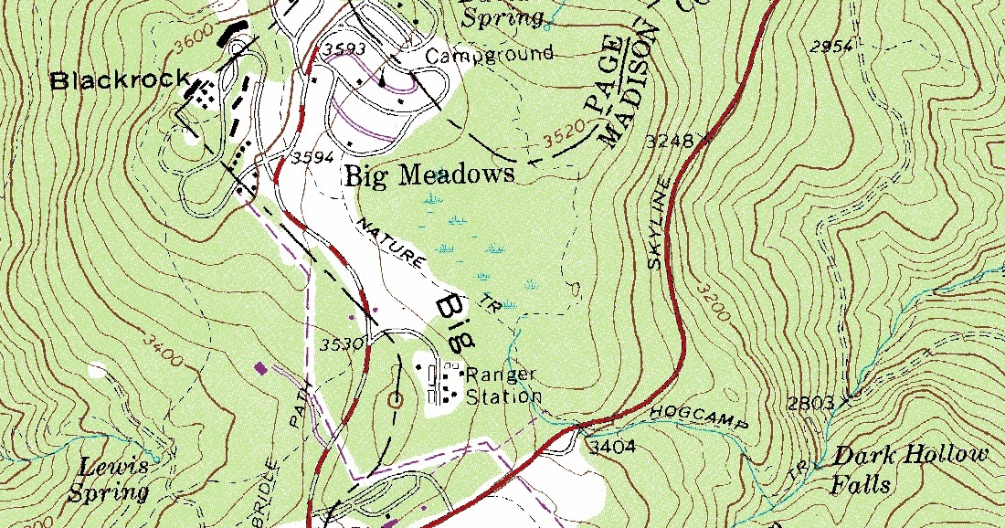
Classification of Maps
Topographic Maps
Show both the horizontal and vertical (relief) positions of features. Topographic maps are commonly referred to as quadrangle or quads.
Contour maps
Shaded-relief maps
Shaded-relief 3D maps
Adjoining maps

Slide 8
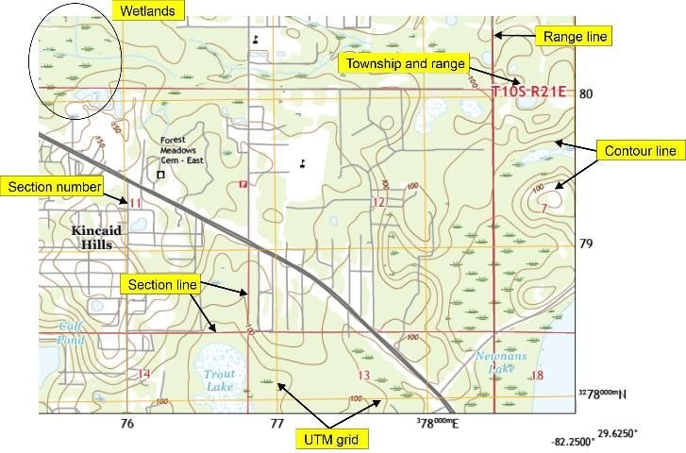
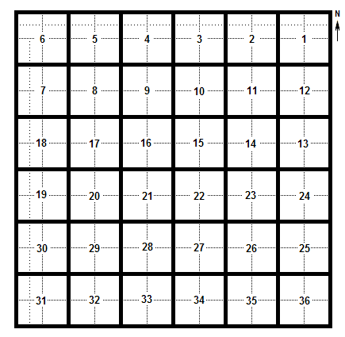
Classification of Maps
Grid System Maps
A grid map is a network of evenly spaced horizontal and vertical bars or lines intended for defining areas and then sections within that area (township, range, section).

Slide 9
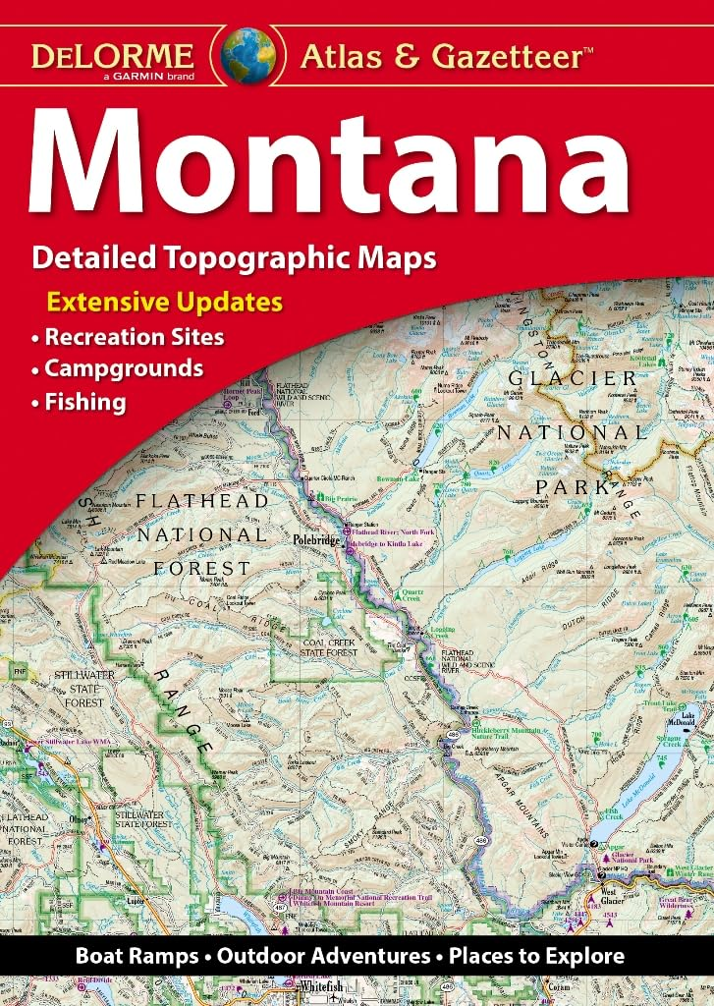
Classification of Maps
Road Atlas
Another common map that can assist resources to respond to a given location.

Slide 10
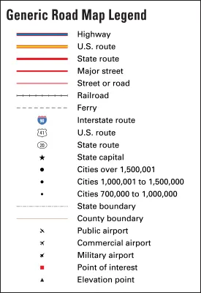
Map Legend
Map Legends
Shows information needed to interpret maps.
Common details:
Roads
Land ownership
Streams/rivers

Slide 11
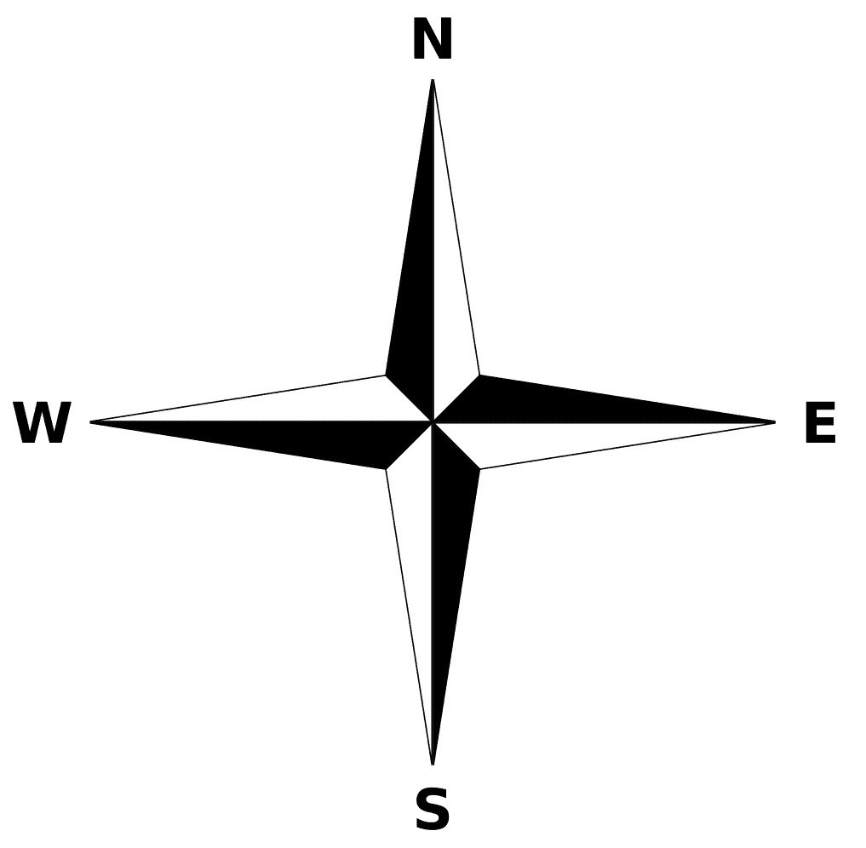
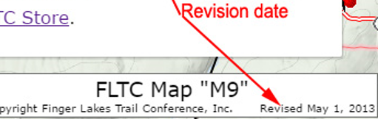
Map Legend
Other common symbols on a map
Cardinal directions
Revision date
Keep in mind, map symbols will not be the same for every map.

Slide 12
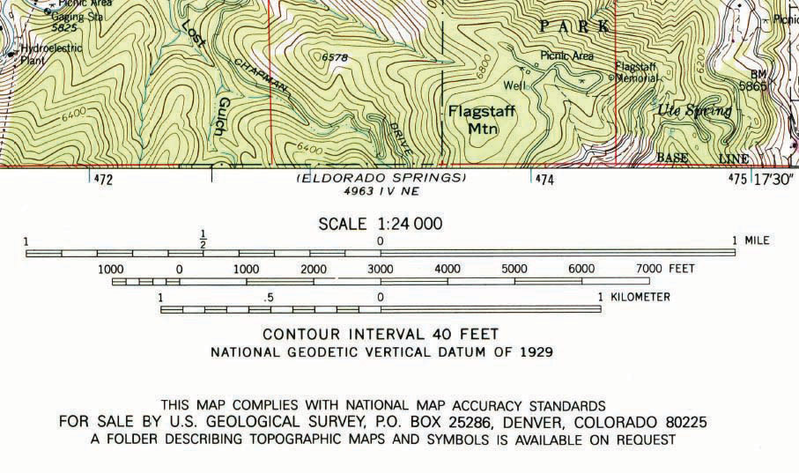
Map Scales
Map Scales
Will indicate the ratio or proportion of the horizontal distance on map to the corresponding distance on the ground.
Three Types
Graphic scale (G.S.)
Representative fraction (R.F.)
Verbal scale (V.S.)

Slide 13
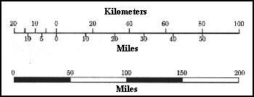
Map Scales
Graphic Scale (G.S.)
Also called a comparison scale, compares map distances on the ground in different units of measurement on a map.
Ex: 1 inch = 50 miles

Slide 14
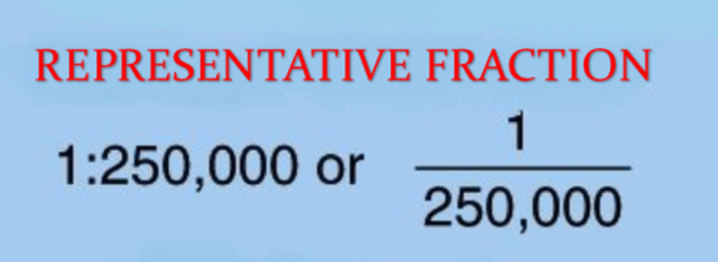
Map Scales
Representative Fraction (R.F.)
One unit of measurement on the map (inches, millimeters, etc.) is equal to the same units on the ground.
Ex: 1”/24,000” or 1”:24,000”
One inch on the map = 24,000 inches on the ground

Slide 15
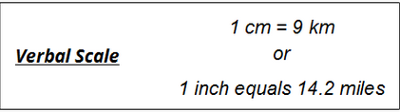
Map Scales
Verbal Scale (V.S.)
Verbal scales use word to describe the relationship between the scale of the map and the real world.
Ex: 1inch = 10 miles

Slide 16
Latitude & Longitude
Latitude
Circle the globe parallel with the equator, running east to west.
Identified by their position north or south of the equator. The equator is 0-degree latitude.
Increase as they approach either the North or South pole.
Longitude
Run true north to true south from the North Pole to the South Pole.
Based on the Prime Meridian which is 0-degree that runs through Greenwich, England.
Closer they are to the poles, the smaller the distance between them.

Slide 17
Latitude & Longitude
Converting Latitude and longitude
Converting seconds to 10ths or 100ths
Number of seconds ÷ 60 seconds = 10ths or 100ths
Example: 15 seconds ÷ 60 = .25 minutes
Converting 10ths or 100ths to seconds
Tenths )or hundredths) x 60 seconds = seconds
Example: .6 seconds x 60 = 36 seconds

Slide 18
Latitude & Longitude
Exercise
Convert: degrees, minutes, seconds (DMS) to degrees, decimal minutes(D,dm).
40° 06’ 23” x 108° 04’ 46”
Answer: 40° 06.38 x 108° 04.77
Convert: degrees, decimal degree (D,dm) to degrees, minutes, seconds (DMS).
43° 57.58 x 119° 54.50
Answer: 43° 57’ 34” x 119° 54’ 29”

Slide 19
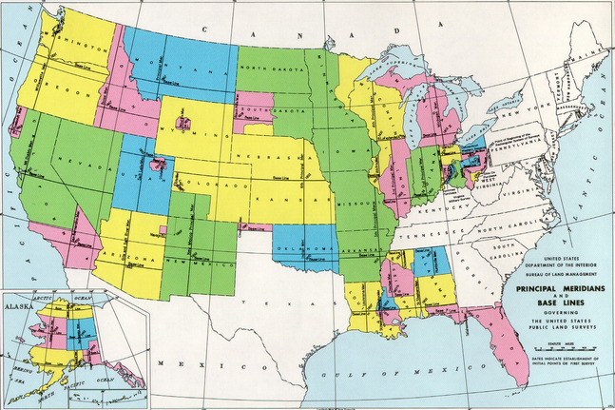
Rectangular Land Description System
Initial Reference Point
Rectangular land division is based on an initial point (also referred to as a reference point).
31 initial points in the conterminous US
All standard lines representing land divisions are based on two reference lines.
The imaginary line on the ground running east-west through the initial point is called the “Base Line.”
The imaginary line on the ground running north-south through the initial point is called the “Principle Meridian.”

Slide 20
Rectangular Land Description System
Correction Lines
Due to the curvature of the earth, additional lines called “Guide Meridians” and “ Standard Parallels” are established from each initial point.
Standard parallels are located at intervals of 24 miles north and south of the base line.
Parallels north of the base line are designated First Standard Parallel North, Second Standard Parallel North, etc.

Slide 21
Rectangular Land Description System
Correction Lines
Guide meridians are established in a similar manner as the Principal Meridian.
Meridian east of the Principal Meridian are designated as First Guide Meridian East, etc., and those west as First Guide Meridian West, etc.
Guide meridians converge due to the curvature of the earth, so the distance between these lines will be 24 miles only at the starting point.

Slide 22
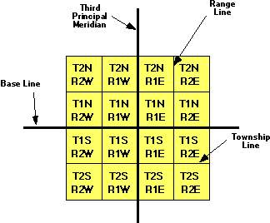
Rectangular Land Description System
Townships and Ranges
Township lines are a series of lines, six miles apart, which run east and west parallel to the Base Line.
The area between the Base Line and the first Township Line on the south side is called Township 1.
The area between the first and second Township lines on the south is Township 2.
The area between the first and second lines on the south is Township 2 south and so on.

Slide 23
Rectangular Land Description System
Townships and Ranges
Range Lines are a series od lines six miles apart, which run north and south parallel to the Principle Meridian.
The areas between these lines are numbered much the same as the township areas.
The area between the Principle Meridian and the first line on the east side is Range 1 East.
The area between the first and second lines on the east side is Range 2 East.
Proper descriptions have the Township written first followed by the Range (T1N, R3E).

Slide 24
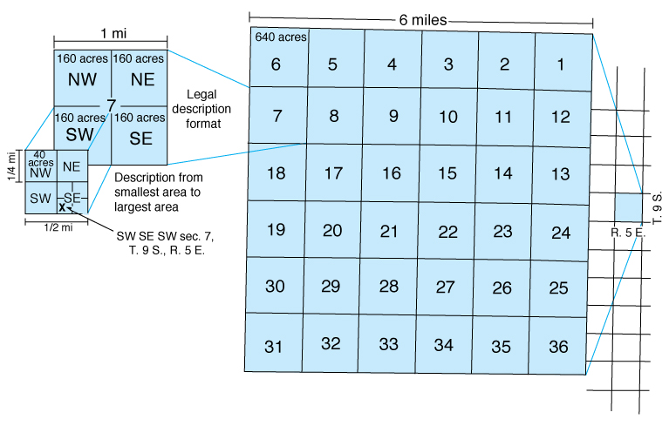
Rectangular Land Description System
Sections
Townships are subdivided into 36 areas.
Each one-mile square.
Section numbering is started in the upper right-hand corner of the Township, moving across to the left, down and to the right.
Each number identifies a section (equivalent to one-square mile or 640 acres).
Sections may not always contain 640 acres, nor are they always one mile.

Slide 25
Rectangular Land Description System
Section Divisions
A typical section of 640 acres may be broken down into smaller areas, each successive smaller piece having a unique location of its own (NW, NE, SW, SE).

Slide 26
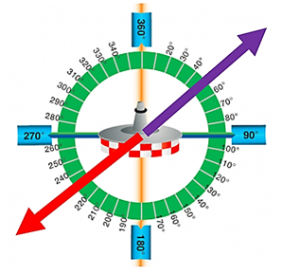
Very High Frequency Omnidirectional Range (VOR)
Transmits a unique radio signal that allows aircraft to determine its bearing relative to the VOR station.
Uses nautical miles.
Uses a 360-degree radial measurement.
Aircraft may give a location in the following format:
Off the Mustang VOR, bearing 175 degrees at 25 nautical miles.

Slide 27
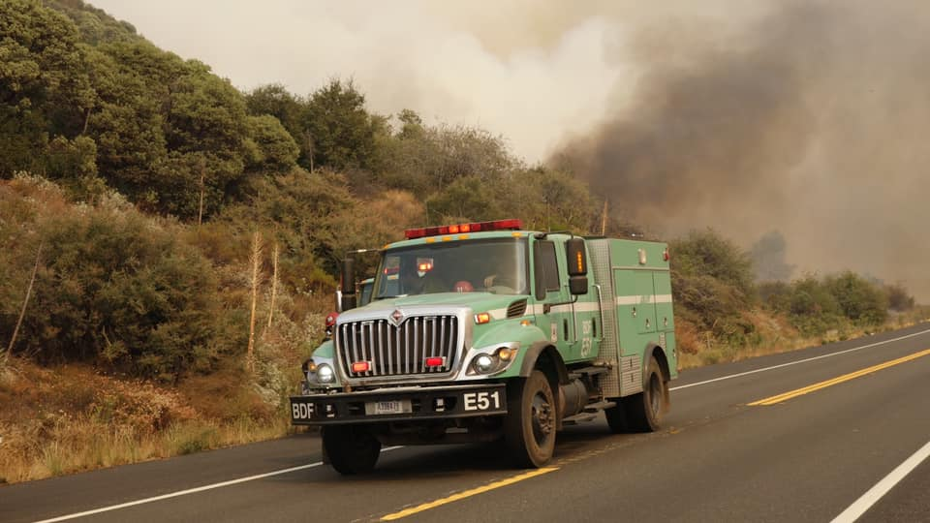
Directing Resource to an Incident
Ground Resources:
Gazetteer Page # and Grid # (pg. 19, A-4)
Latitude and longitude
Township, Range, Section
Air Resources:
Latitude and longitude
VOR distance and bearing
Aeronautical charts

Slide 28
Knowledge Check
Using the Burns Interagency Fire Zone Map, complete the following:
Plot Section 24, T17S, R36E. What do you find there?
Black Butte
Plot 43° 50’ 00”N x 118° 58’ 00”W. What do you find there?
Crow Flat Guard Station
Convert 43° 35.27N x 119° 03.78W to D.M.S. and plot. What is the conversion and what do you find there?
43° 35’ 16”N x 119° 03’ 46”W
City of Burns
Find the Pueblo Helibase on the map.
What is the latitude/longitude in D.M.S. of the base?
42° 24’ 00”N x 118° 52’ 52”W
What is Section, Township, Range of the base?
Section 28, T36S, R32.5E
What is the land status agency for the Wolf Creek Incident?
U.S. Forest Service

Slide 29
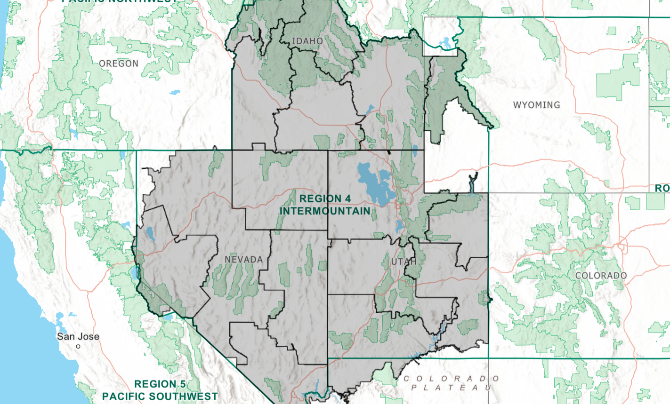
Summary
Identify the different types of maps and how they relate to fire dispatching for assisting with planning and operations.
Effectively plot locations using latitude/longitude, grid maps, and township, range, and section.
Effectively locate and triangulate a given location using existing VOR systems.
Describe information needed to direct resources to a plotted location.
Notes:
Guides and Key
The presentations and instructor guides include notes to aid facilitators in instruction.
Key
Indicates an action for the instructor to take.
Indicates topics and information for the facilitator to use as they see fit.
Example Notes
Review unit objectives.
Exercise
Advise participants that the next few slides will introduce common terms that describe parts of a fire.
Pre-Video Discussion
In this scenario, firefighters have arrived on scene of a new fire. They are gathering and communicating their situational awareness of the current fire behavior.
Play Video
Title Basic Fire Terminology
Summary State the summary
Time (02:20)
Audio
Post-Video Discussion
This unit will discuss many of these terms in more detail.
Question: Identify this fire behavior.
Answer: Torching
Note to Instructor
The fuel types listed on this slide will be discussed in detail in Unit 2.
List Level 1
List Level2
Example
Example
List Level 1
List Level 1

